Slide 1

Visualizing Benefit-Risk 2019 PSI Conference
Mike Wright Colopy, PhD
UCB Biosciences
03.MAY.2019 London

Slide 2
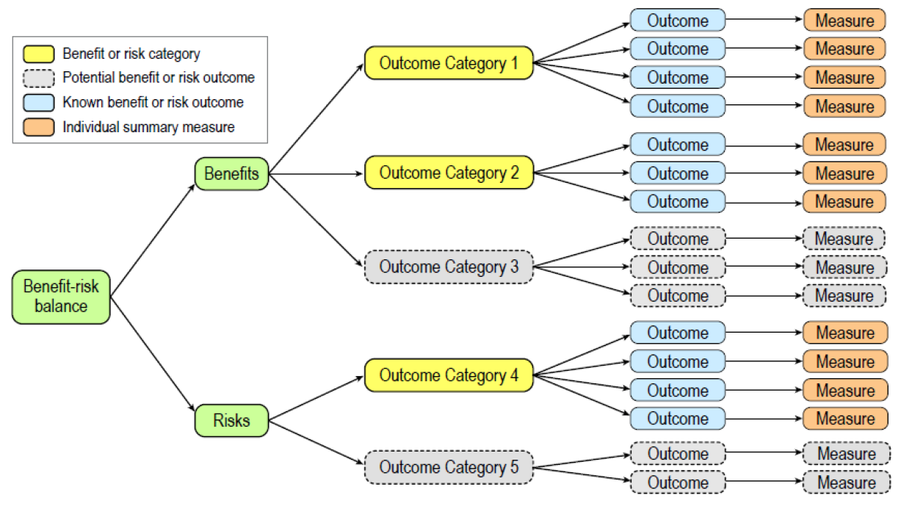
The benefit-risk story starts with a tree and grows throughout drug development
Ref. BRAT Documentation

Slide 3
A decade has passed
Many of the graphs for benefit-risk assessment were published around 2008.
Since 2008, interactive graphic software has made them easier to generate.
Yet, the graphs are not used as much as anticipated.
Adoption may require a better understanding of their added value,
and a benefit-risk assessment plan that integrates them into
a company’s R&D processes for internal & external decision-making.
Don’t wait for a ‘one size fits all’ graphical solution or
for all of your efficacy & safety evidence to begin your assessment.

Slide 4
Added Value to Decision Making
Communicates the B&R balance
Uses drug attributes that are meaningful to multiple stakeholders
Synthesizes multiple B&R having different metrics
Incorporates uncertainty (distribution, variance, quality of evidence & generalizability)
Shows correlation between B&R
Identifies subgroups, heterogeneity and interactions
Shows time trends
Integrates judgement with clinical evidence
Sensitive to choice of B&R estimands
Basically, does it move the decision out of the gray area?

Slide 5
Goal: Continuous updates to BRA Frameworks
FDA Framework
Decision Factor | Evidence & Uncertainties | Conclusions & Reasons
Analysis of Condition
Current Treatment Options
Benefit
Risk & Risk Management
Benefit-Risk Integrate Assessment
EMA – PROACT-URL
1. Problem 2. Objectives 3. Alternatives 4. Consequences 5. Trade-offs 6. Uncertainty 7. Risk tolerance 8. Linked decisions
Planning
Evidence
Analysis
Exploratory
Decision
(Ref. Mt-Isa, 2012)

Slide 6
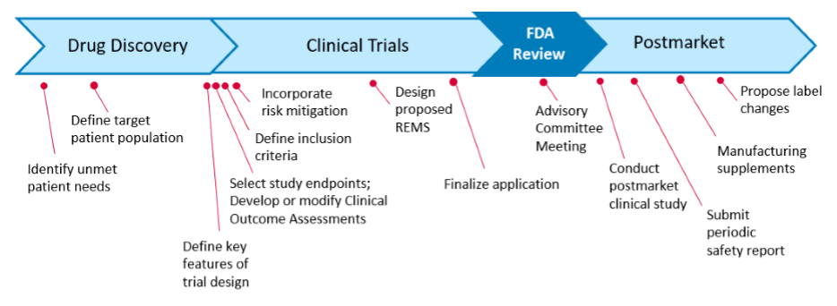
Milestones along the drug lifecycle
Ref. FDA BRA Discussion Document, 2019

Slide 7
Discovery – Preclinical Development
Requirements:
- Target Product Profile, Clin. Dev. Plan & Investigator Brochure
Benefit-Risk Plan:
- Framework: Analysis of Condition & Current Treatment Options
- Simulations using published data on alternative therapies
Graphs:
- Value tree, forest plot, BR plane & BR trade-off plots for alternatives.

Slide 8
Clinical Development
Requirements:
- IND Reporting, Safety SAP, DSURs, Regulatory meetings, Risk Management
- Proof of Concept, Go-NoGo decisions, Dose selection, Estimands
Benefit-Risk Plan:
- Framework: Benefits, Risks, Uncertainties (in expectations & values)
- Reference background rates
- Elicitation of medical judgement & preferences
Graphs:
- Qualitative - Value tree, forest plot, Norton plots, BR plane (by dose & subgroups)
- Quantitative - BR trade-off plots, Preference trade-offs, MCDA plots

Slide 9
Regulatory Review
Requirements:
- Common Technical Document Section 2.5.6
- RMPs
Benefit-Risk Plan:
- Framework: Benefits, Risks, Uncertainties, Risk Management,
Summary
- Risk tolerance: elicitation of medical judgement & preferences
Graphs:
- Qualitative - Value tree, forest plot (by dose & subgroups)
- Quantitative - BR trade-off plots, MCDA plots

Slide 10
Post-Market
Requirements:
- PSUR & PBRER Section 2.5.6
- REMS
- Patient segmentation
Benefit-Risk Plan:
- Framework: updates, label changes & multiple indications
- Elicitation of medical judgement & preferences
Graphs:
- Qualitative - Value tree, forest plot, BR plane (by dose & subgroups)
- Quantitative - BR trade-off plots, Physician-Patient Preference
trade-offs, MCDA plots, QALYs, patient decision aids

Slide 11
Basic BR Trade-Off Graph
Categorical data
Continuous data
 | No Benefit | Benefit
Harm | Unacceptable
No Harm |  | Ideal
ΔHarm
Unacceptable
Ideal
Δ Benefit
Max. Acceptable Risk
Min. Acceptable Benefit

Slide 12


Basic BR Trade-Off Graph
Points can be:
Individual patients
Dose groups (A,B,C)
Age-Sex groups
Treatment groups
Different estimands
Many options for axes
Change from baseline
Treatment difference
ΔHarm
C
B
A
Δ Benefit

Slide 13
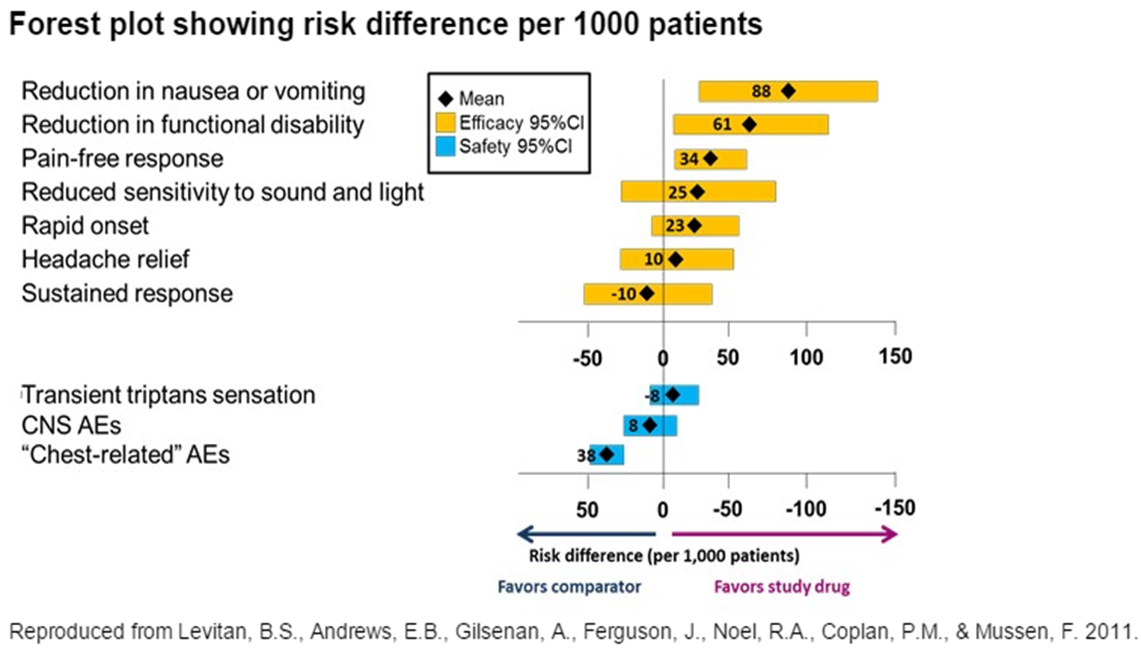
Forest Plot
Planning phase: display data for alternative therapies based on value tree
Analysis phase: display your late phase data
Strengths
Communicates the B&R balance
Uses B&R that are meaningful to multiple stakeholders
Synthesizes multiple B&R having different scales
Incorporates uncertainty (variance)
What is required to show correlation?

Slide 14
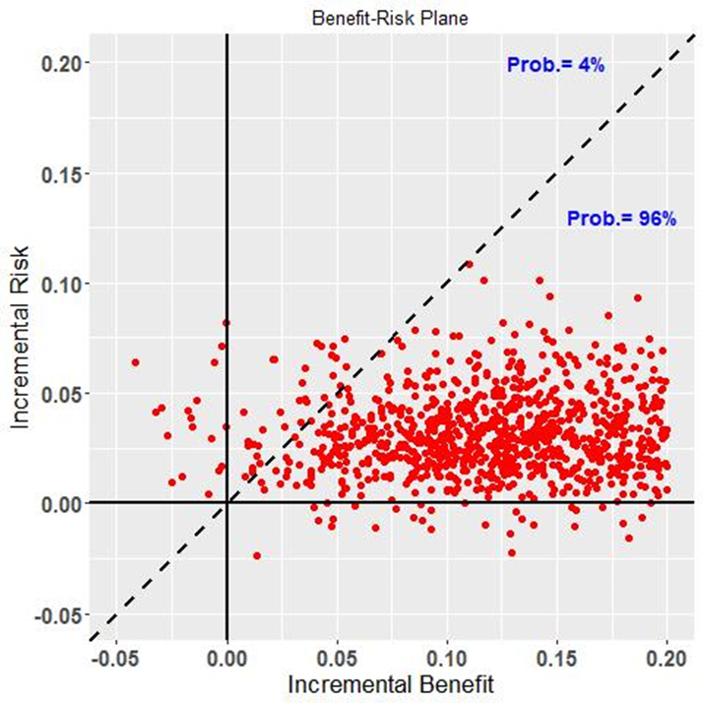
Benefit-Risk Plane
Planning phase: display simulated data for alternative therapies
Analysis phase: display your late phase data; color code patient subgroups
Strengths
1. Communicates the B&R balance
4. Incorporates uncertainty (variance)
5. Shows correlation between B&R
6. Identifies subgroups& heterogeneity
8. Integrates judgement with clinical
evidence
Weakness
Single risk and benefit
What is required to show time trends?
Ref. Lynd & O’Brien, 2004

Slide 15
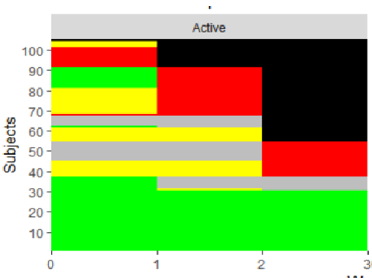
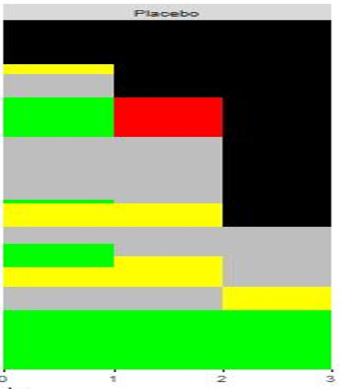
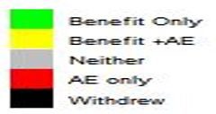
Norton Heatmap
Analysis phase: display of late phase data on individual patients
Additional Strengths
5. Shows correlation between B&R
6. Identifies heterogeneity
7. Shows time trends
Weakness
Limited no. of risks and benefits
Difficult to summarize
What is required to integrate judgement?
Ref. Norton, 2011

Slide 16
Desirability of Outcome Ranking (DOOR)
1st integrate benefit and risk at the patient level
2nd summarize at the group level, taking advantage of the association between benefits and risks.
Ref. Scott Evans, 2016.
https://www.ncbi.nlm.nih.gov/pubmed/28435515
Example:
5 Outcomes
Simple ranking integrates
judgement but avoids
weighting
Limited no. attributes.
 | Rank | Composite Outcome
 | 1 | Clinical benefit without AE
 | 2 | Clinical benefit with AE
 | 3 | Survival w/o clinical benefit or AE
 | 4 | Survival w/o clinical benefit + AE
 | 5 | Death

Slide 17
Integrating Judgment & Clinical Evidence Welcome to quantitative benefit-risk assessment !
Combined Metric
- Quality-Adjusted Life-Years (QALY)
- Quality-adjusted Time Without Symptoms and Toxicity (Q-TWiST)
- Incremental Net Health Benefit (INHB)
Thresholds
- Benefit-Risk Pair
Utilities or Weights Clinical Utility Index
- Multiple benefits & risks

Slide 18
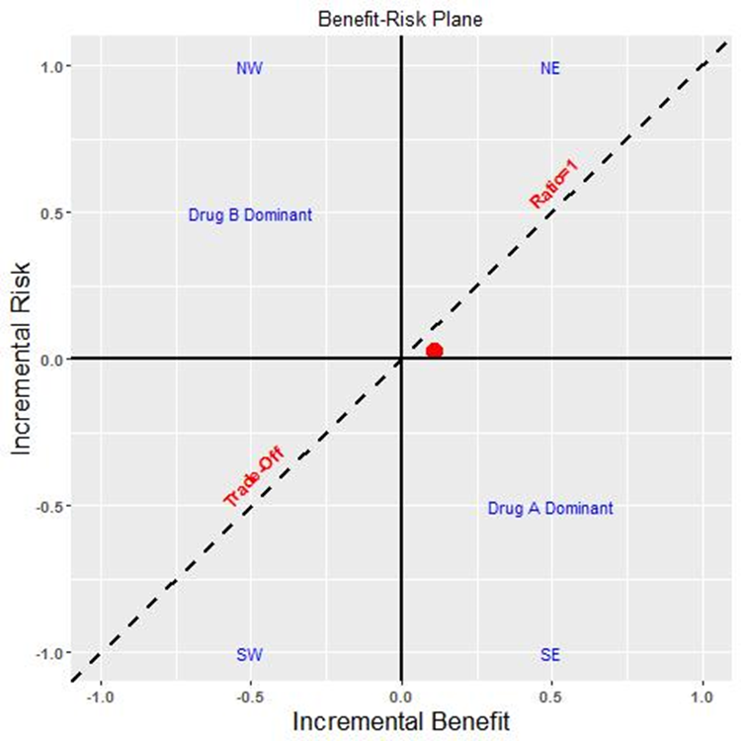
Benefit-Risk Plane with Threshold
Planning phase: display data for alternative therapies; elicit threshold
Data
Analysis phase: display late phase data
A steeper slope indicates a higher risk tolerance or weighting of B & R.
The “threshold technique” can be used to elicit a linear or nonlinear trade-off line.

Slide 19
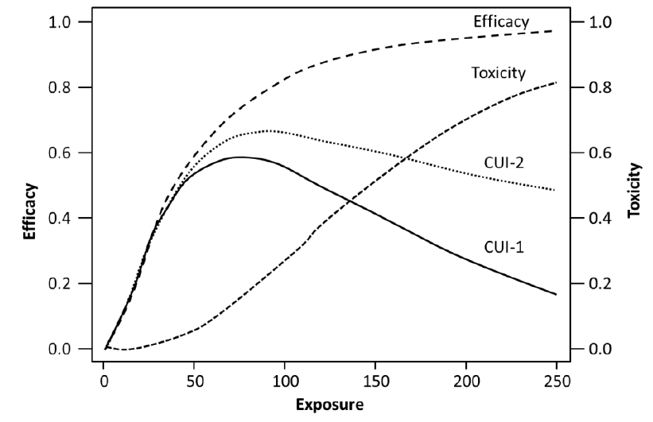
Efficacy-Toxicity Exposure
Analysis phase: display late phase data
Additional Strength
Relationship of B & R over time at the group level.
Weakness
Loss to follow-up rates for groups
Ref. Mt-Isa, Stage 1, 2013

Slide 20
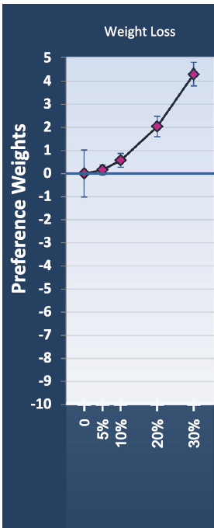
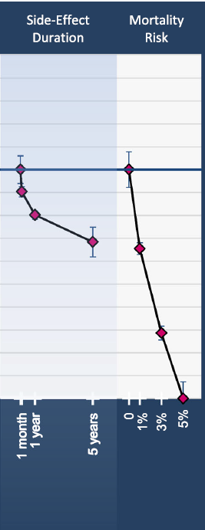
Discrete Choice Experiments
Analysis phase: display phase 3 & post-approval preference data
Additional Strengths
Not only compares multiple benefit & risk
but at a range of levels
Can identify subgroups, heterogeneity
and interactions
Weakness
Assumes attributes preferences are
independent.
- All judgement, no clinical data.
Attributes Levels
Ref. Ho, 2015

Slide 21
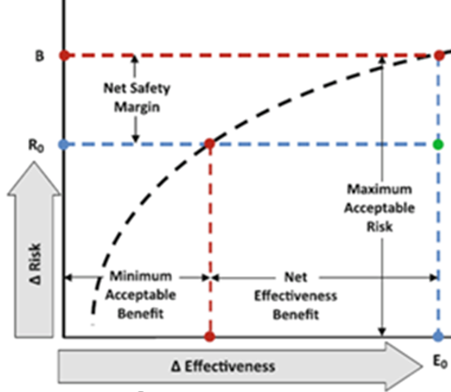
B-R Trade-off Curve
Analysis phase: display phase 3 & post-approval data
Additional Strengths
5. Shows correlation between B&R
8. Integrates judgement with clinical evidence
9. Assess direction of estimands
Weaknesses
- Single benefit and risk
Trial endpoints & preference
attributes might not be aligned
unless planned.
2
1
(Ref. Johnson & Hauber, 2008

Slide 22
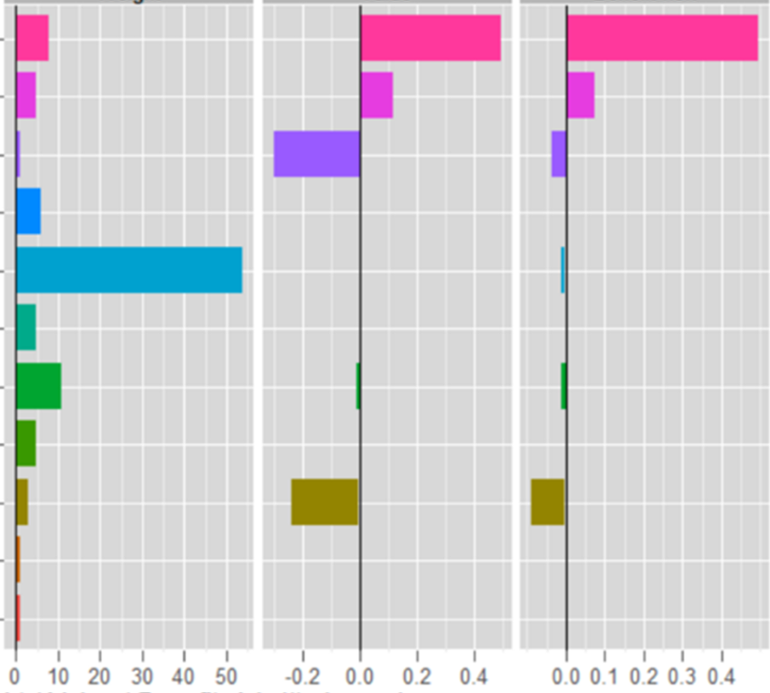
Multi-Criteria Decision Analysis
Planning phase: display simulated data for alternative therapies
Analysis phase: display your late phase data for different stakeholder weights
Weight Value Benefit-Risk
Additional Strengths
8. Integrates judgement with clinical evidence
Weaknesses
Identifying subgroups, heterogeneity and
interactions
Assuming benefits & risks (decision
criteria) are independent thus allowing
their scores to be summed at the group
level.
A
B
C
D
E
F
G
H
I
J
K
Ref. Phillips, 2015; Hughes, 2016

Slide 23
Summary
- There is no ‘One Size Fits All” graph for benefit-risk assessment.
- The Forest Plot meets ½ of the graphical needs or added value.
- Other types of graphs can display the relationship between benefits & risks,
their distributions, time trends, and impact of estimand specification.
- Displays of trade-off and preferences can help identify subgroups most likely to benefit and adhere to treatment.
- To quantitatively assess trade-offs, clinical background rates, medical judgement and patient preferences can be integrated with hard clinical evidence.
- Benefit-risk assessment and visualizations can be implemented at every stage of drug development, by updating its decision framework continuously.

Slide 24
Reference Materials
CIRS. The BRAT Framework for Benefit-Risk Assessment User’s Guide to the Process Version 1.0, 2013. http://www.cirs-brat.org/
FDA, Benefit-Risk Assessment Throughout the Drug Lifecycle: FDA Discussion Document May 3, 2019.
https://healthpolicy.duke.edu/sites/default/files/atoms/files/discussion_guide_b-r_assessment_may16_0.pdf
Lynd LD and O’Brien BJ. Advances in risk-benefit evaluation using probabilistic simulation methods: an application to the prophylaxis of deep vein thrombosis. J Clin Epidemiology. 57 (2004) 795-803.
Mt-Isa S, Wang N, Hallgreen CE, et.al. Review of methodologies for benefit and risk assessment of medication. IMI PROTECT Consortium Report 14FEB2012.
Mt-Isa S, et.al. IMI PROTECT Consortium Work Package 5 members Review of visualisation methods for the representation of benefit-risk assessment of medication: Stages 1 & 2, 2013.
Halgreen CE, et.al. Literature review of visual representation of the results of benefit–risk assessments of medicinal products. Pharmacoepidemiology and Drug Safety, 2016; 25: 238–250.
Hughes D, et.al. PROTECT Benefit–Risk Group. Recommendations for benefit–risk assessment methodologies and visual representations. Pharmacoepidemiology and Drug Safety, 2016; 25: 251–262.

Slide 25
Reference Materials
Norton J. A Longitudinal Model and Graphic for Benefit-risk Analysis, With Case Study. Drug Information Journal, Vol. 45, pp. 741–747, 2011.
Johnson FR and Hauber B. Quantifying Patient Benefit-Risk Tradeoff Preferences: A Brief Introduction. RTI HS white paper 2008.
Walker S, Phillips L and Cone M . Benefit-Risk Assessment Model for Medicines: Developing a Structured Approach to Decision Making Report of the Workshop organised by the CMR International Institute for Regulatory Science, 13-14 June 2005.
Evans S, Statistics in Biopharmaceutical Research, (2016) 8:4, 386-393.
Ho MP, et.al. Incorporating patient-prefence evidence into regulatory decision making. Surg Endosc. January 2015.

Slide 26
Reference Materials
FDA: Benefit-risk assessment in drug regulatory decision-making. Draft PDUFA VI Implementation Plan (FY 2018-2022) 2018.
FDA Public Workshop II: Benefit-Risk Assessments in Drug Regulatory Decision-Making, 2017. https://www.fda.gov/industry/prescription-drug-user-fee-amendments/public-workshops-benefit-risk-considerations.
Phillips LD, On behalf of PROTECT Benefit-Risk Group. Modelling the benefit-risk of medicinal products using Hiview 3, 2015.

Slide 28
Thanks!

